Slide 1
Key Stage 4 Option Choices
Thursday 25th January 2024
Mrs Keenan

Slide 2
The Core Curriculum
Subject | GCSE/Course
English Language and Literature | 2 GCSEs
Mathematics | 1 GCSE
Double award Science Students will be selected to do Triple science (3 GCSES) | 2 or 3 GCSEs
Religious Studies | 1 GCSE
Citizenship Studies | 1 GCSE
Physical Education | Non GCSE
AND AT LEAST ONE FROM
History, Geography or a MFL

Slide 3
Option Subjects
Students will be able to state a preference to study up to 3 subjects from the following list:
Art
Business Studies
D&T either
Food
Product Design
Textiles
Drama
Geography
Health & Social Care BTEC
Music Technology BTEC
ICT BTEC
History
Languages
French
Spanish
Media Studies
Music
PE
Support- SEN/ EAL/HSD

Slide 4
Option Blocks
The option subjects are arranged into blocks as shown in the options booklet and on the preference form.
Only one subject can be selected from each block. A reserve subject should also be made from each block.
Subjects will only run if they attract a sufficient number of students.

Slide 5
 | A | B | C
Section 1 Students must choose at least one from this section | Geography History Spanish | Geography History French | Geography History Spanish
Section 2 Students may choose up to 2 subjects from this section | Business St Media Studies (25) Product Design Textiles PE | Art Business St Food Music | Music Tech BTEC (15) Health& Social Care (BTEC) ICT(BTEC) Drama
 | HSD/SEN support EAL support | HSD/SEN support EAL support | HSD/SEN support EAL support
Choose 1 subject from each block
Reserve

Slide 6
Students selecting Media Studies and Music Technology must complete the task if they wish to be considered for this option.
Please do not select these as a reserve option.
The support options are offered to students who, following guidance from the learning support department, would benefit from increased support and a reduced number of GCSEs

Slide 7
Media Studies: The Task
Only 25 spaces in GCSE Media for September
Each student will need to complete a task to be considered for entry. The task will be reviewed and places will be awarded.
No Task = No Entry.
Potential will be valued.

Slide 8
The Task
Part 1 – Film Poster Design
- Must be an original idea
- Hand drawn or computer based
Part 2 – Film/TV Review
- 500 words
- Must be a film or tv show you
have watched in the last year.
DEADLINE:
Wednesday 7th FEBRUARY
4pm
ONLINE via SATCHEL ONE

Slide 9
Important information about choosing Music Technology. Music Technology is a very popular option, unfortunately there are often more students who apply for the subject than we can actually admit onto the course. We can only accept 15 students onto the Music Technology course. As such, if you are considering Music Technology, then you MUST complete the task below and hand it in to Mr Beitlberger in X2 by Friday 28th January at the latest. Mr Beitlberger will read through your work and then advise the school as to whether he thinks you would be a suitable candidate for the course. If the task below is not completed and submitted by Friday 28th January, then Mr Beitlberger will be unlikely to consider you for the course. If you are not sure as to whether you are going to opt for Media Studies or not, we advise you to complete the tasks and hand them to Mr Beitlberger anyway so that should you decide further down the line that you do want to choose the subject, then you will still be in with a chance of attaining a place on the course.
Design a Music Technology poster (can be either hand drawn, painted, collaged, or done on a computer and printed out) on what you think Music Technology is. Make sure the poster looks appealing. Include artists, genres of music that embrace music technology, and Music Technology Software. For this tasks, Mr Beitlberger will be considering the standard of your work, the presentation of your work, and your creative ideas.

Slide 10
Submission of Choices
Completing the preference form on line NOT ON paper!
Every student has been sent a link to their school email account to enable them to access Options Online. All option choices must be completed using this system.
Remember – blue is your 1st choice
orange is your reserve choice
PRESS SAVE

Slide 11
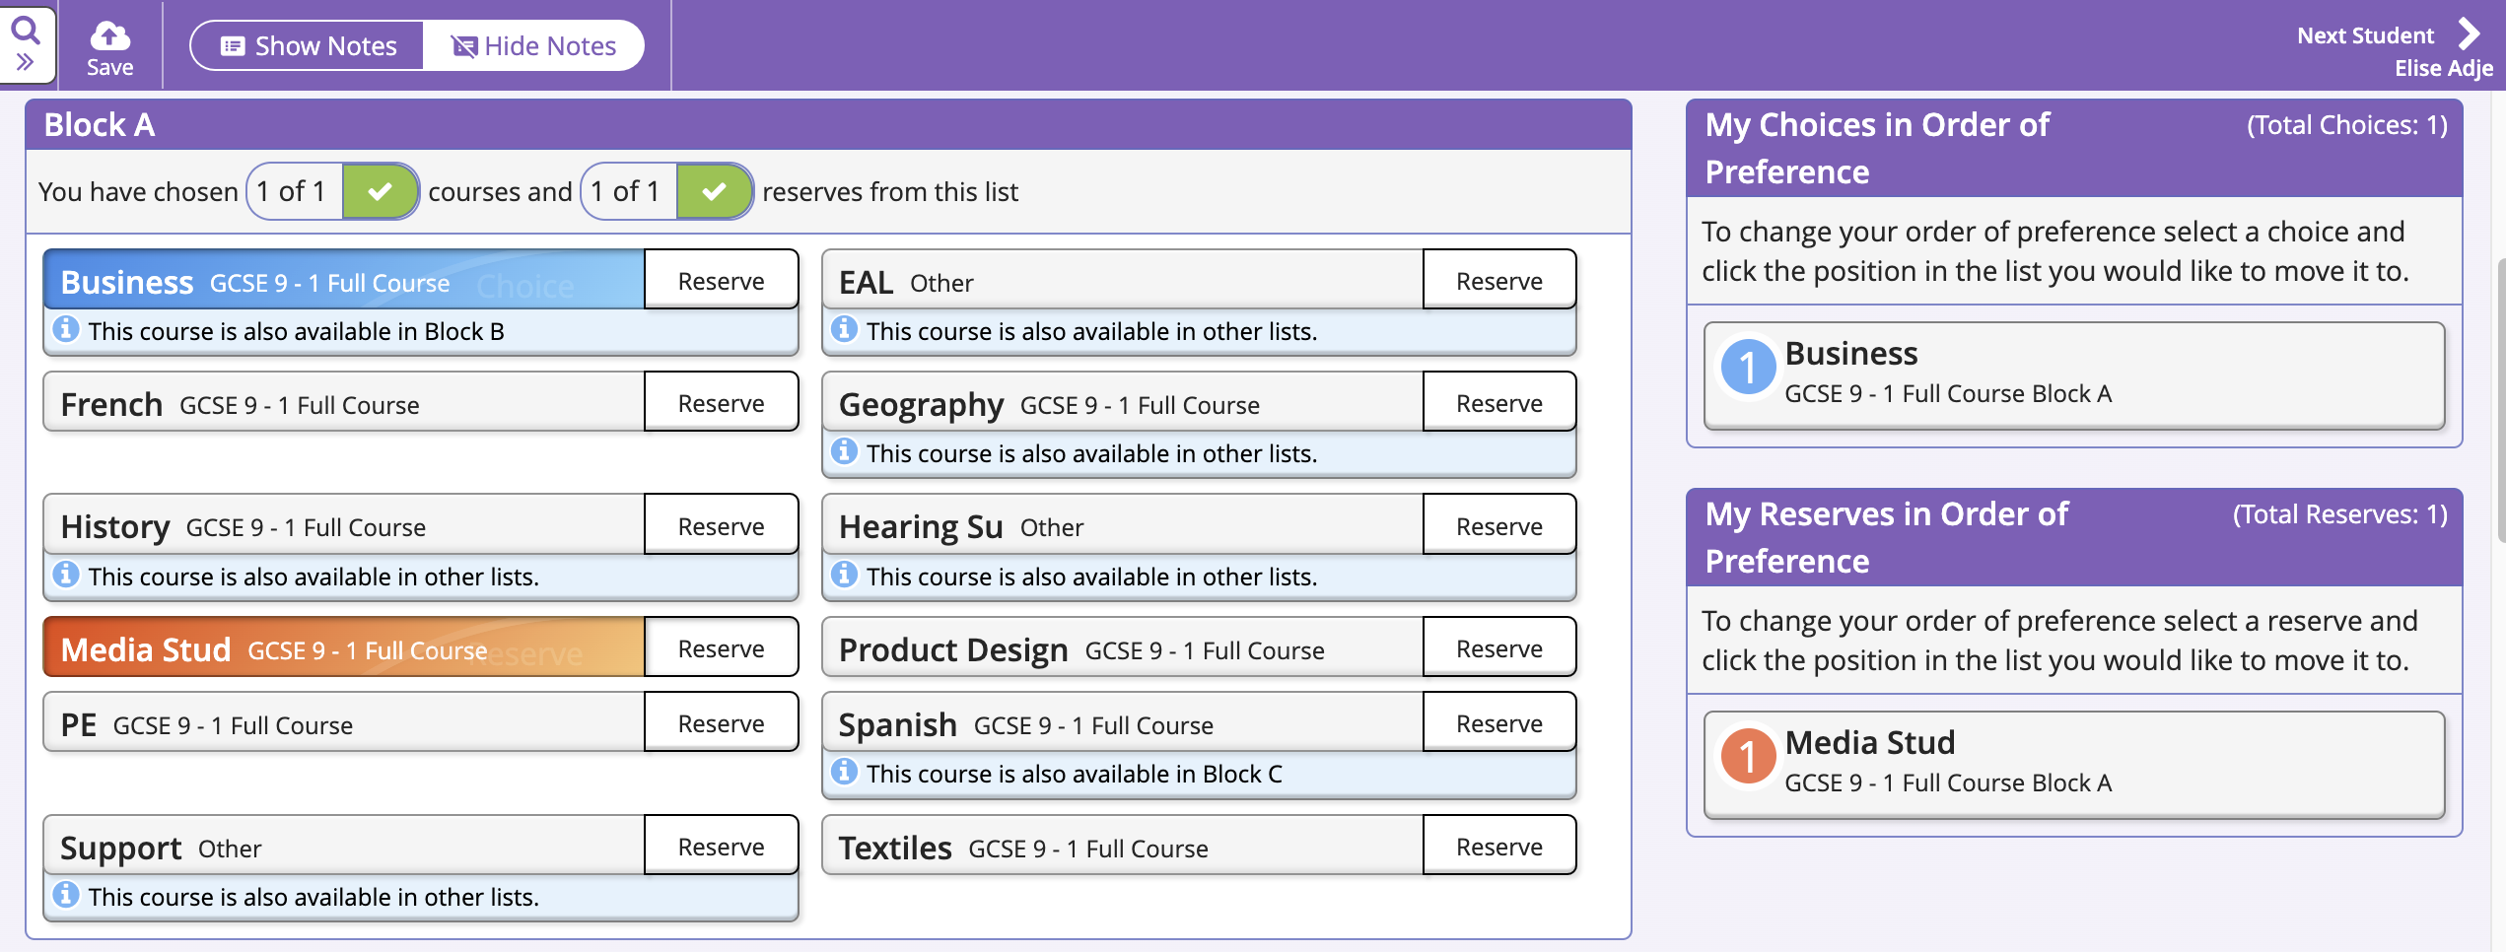

Slide 12
Example 1 11 GCSEs – Ebacc route Ebacc – students will choose Geography or History AND a language
CORE – 8 GCSEs
English
English Literature
Maths
Triple Science (3)
Religious Studies
Citizenship Studies
OPTIONS – 3 GCSEs
PE
B. Geography
C. Spanish

Slide 13
 | A | B | C
Section 1 Students must choose at least one from this section | Geography History Spanish | Geography History French | Geography History Spanish
Section 2 Students may choose up to 2 subjects from this section | Business St Media Studies (24/1 group only) Product Design Textiles PE | Art Business St Food Music | Music Technology BTEC Health& Social Care (BTEC) ICT (BTEC) Drama
 | HSD/SEN support EAL support | HSD/SEN support EAL support | HSD/SEN support EAL support
Choose 1 subject from each block | PE | Geography | Spanish
Reserve

Slide 14
Example 2 9 GCSEs & 1Btec
CORE – 7 GCSEs
English
English Literature
Maths
Double award Science (2)
Religious Studies
Citizenship Studies
OPTIONS – 1 GCSE and one alternative level 2
History
Food
C. Music technology BTEC

Slide 15
 | A | B | C
Section 1 Students must choose at least one from this section | Geography History Spanish | Geography History French | Geography History Spanish
Section 2 Students may choose up to 2 subjects from this section | Business St Media Studies (24/1 group only) Product Design Textiles PE | Art Business St Food Music | Music Technology BTEC Health& Social Care (BTEC) ICT (BTEC) Drama
 | HSD/SEN support EAL support | HSD/SEN support EAL support | HSD/SEN support EAL support
Choose 1 subject from each block | History | Food | Construction
Reserve

Slide 16
Example 3 8 GCSEs & 1 BTEC
CORE – 7 GCSEs
English
English Literature
Maths
Double award Science (2)
Religious Studies
Citizenship Studies
OPTIONS – 1 GCSE
Support (0)
Geography
C) Health & social care Btec

Slide 17
 | A | B | C
Section 1 Students must choose at least one from this section | Geography History Spanish | Geography History French | Geography History Spanish
Section 2 Students may choose up to 2 subjects from this section | Business St Media Studies (24/1 group only) Product Design Textiles PE | Art Business St Food Music Media Studies (24/1 group only) | Music Technology BTEC Health& Social Care (BTEC) ICT (BTEC) Drama
 | HSD/SEN support EAL support | HSD/SEN support EAL support | HSD/SEN support EAL support
Choose 1 subject from each block | Support | Geography | Health& Social Care
Reserve

Slide 18
Vocational courses
There is a now a minimum of 20% externally assessed units
BTEC Health &Social care
BTEC Music Technology – new course Sept 2024
BTEC ICT
Students must be prepared to work hard. They are not an easy option

Slide 19
Options Process
25th January – Student presentation
25th January – Parents presentation
1ST February – Yr 9 Parents evening ONLINE
7th February – deadline for Media/ Music Tech task
9th February – Options Returns deadline ONLINE
19th Feb onwards – Options Interviews with Mrs Keenan (if needed)

Slide 20
Key advice
Choose courses that:
Students know that they can do well in.
Are subjects that they enjoy and work hard in
Reflect their interests and personal qualities.
Help students to learn in the best way for them
Will help them in their career aims or to move onto A level
Students are advised:
To keep their options open for the future by choosing a broad and balanced range of subjects
All students must continue with either a Modern Foreign Language , Geography or History.

Slide 21
Key Stage 4 curriculum changes
There have been significant changes to GCSE and BTEC qualifications in recent years.
These changes include a return to exams taken at the end of the course
Measures to improve the assessment of spelling, punctuation and grammar have been introduced.
Students will still be able to retake a full GCSE in Maths and English in November 2026 if they do not get a Grade 4.
Controlled assessments have been phased out in all GCSEs and have been replaced with what is now known as the Non-Examined element which are internal assessments
Spelling, punctuation and grammar
Marks will be awarded for accurate spelling, punctuation and use of grammar in GCSE exams that have a sufficient written English element e.g. English literature, Geography, History and Religious studies.
BTECs and other vocational courses
At least 20% will be externally assessed.

Slide 22
Further Advice
Students are advised to speak to tutors, teachers and their Head of Year.
Specific subject issues can be discussed at the Year 9 parents evening.

Slide 23
Options Process
25th January – Student presentation
25th January – Parents presentation
1ST February – Yr 9 Parents evening ONLINE
7th February – deadline for Media/ Music Tech task
9th February – Options Returns deadline ONLINE
19th Feb onwards – Options Interviews with Mrs Keenan (if needed)

